Slide 1


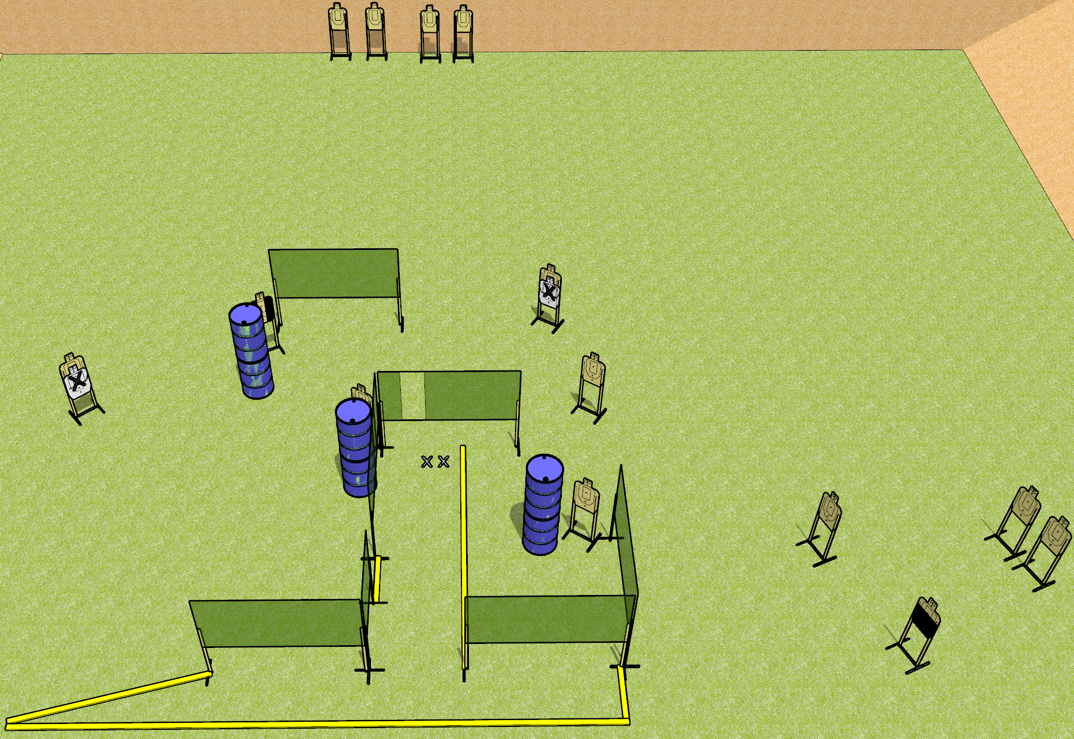
 | Dothan Gun Club – USPSA Match Use the Big Bay Course Designer : Drew Coleman
Round Count 28 rounds 14 USPSA targets
Equipment List 11 wall feet 2 3’ fault lines Use 10 foot for the far left angled part.

Slide 2
Use the Big Bay
Written Stage Briefing
Use the Big Bay is a 28 round, 140 point, Comstock course of fire. There are 14 USPSA targets. The best 2 hits on paper will score, and steel must fall to score. The start signal is audible.
Handgun start position is both feet on X’s, wrists below belt. Handgun is loaded and holstered.
PCC start position is both feet on X’s, stock on belt. Loaded carbine is held with both hands, safety on.
On start signal, engage targets as they become available from within the shooting area.

